Slide 1
Building a Soft Margin SVM to Classify Tumors
Shiv Bhutani

Slide 2
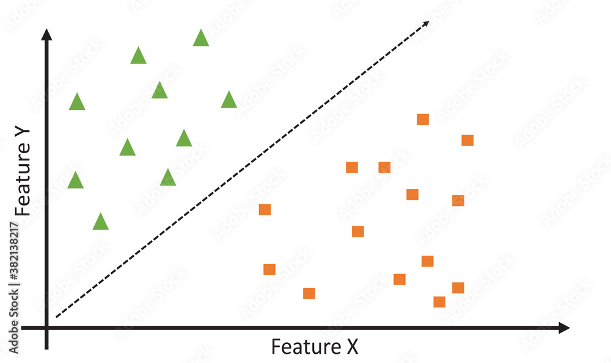


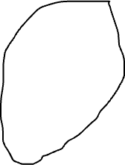


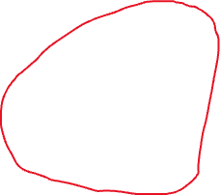

Basic Definitions
What is SVM?
A Support Vector Machine (SVM) is a supervised machine learning algorithm used for binary classification.
It works by finding the hyperplane that best separates the data into two classes.

Slide 3
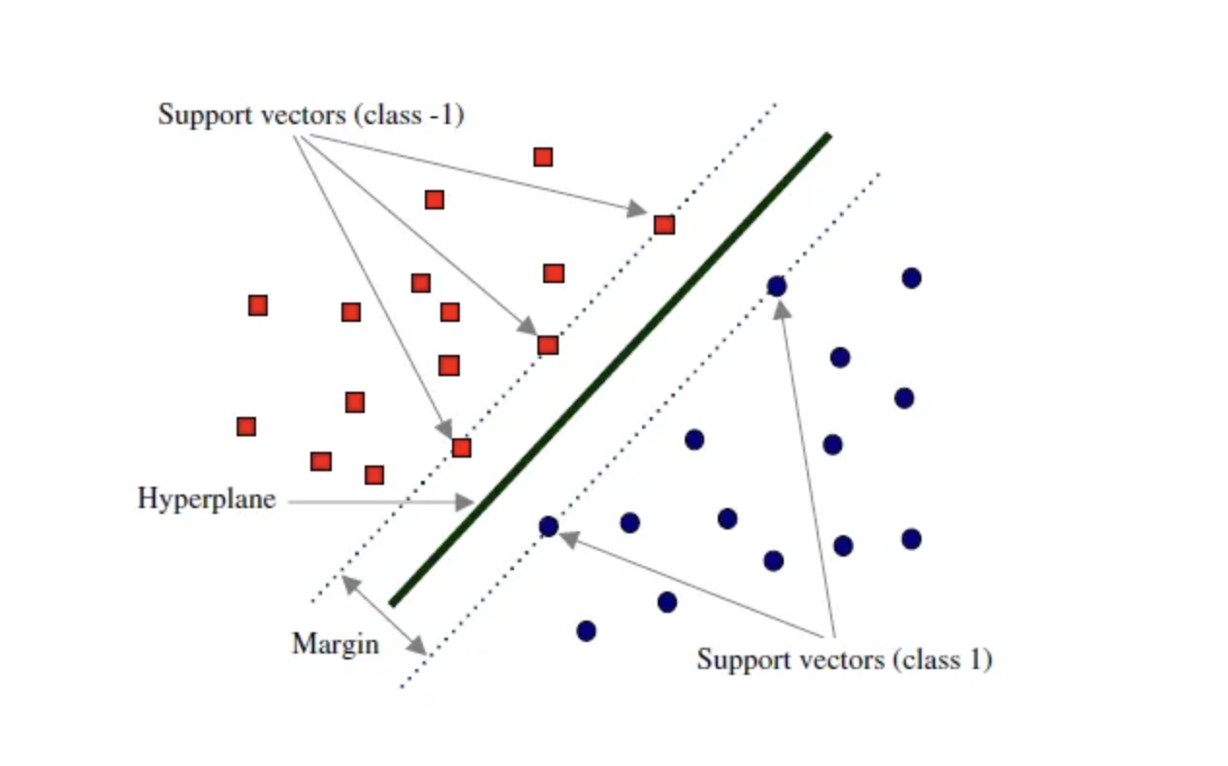
Basic Definitions cont.
Key Concepts:
Hyperplane: A decision boundary that separates different classes.
Support Vectors: Data points that are closest to the hyperplane and influence its position.
Margin: The distance between the hyperplane and the nearest data points from either class.

Slide 4
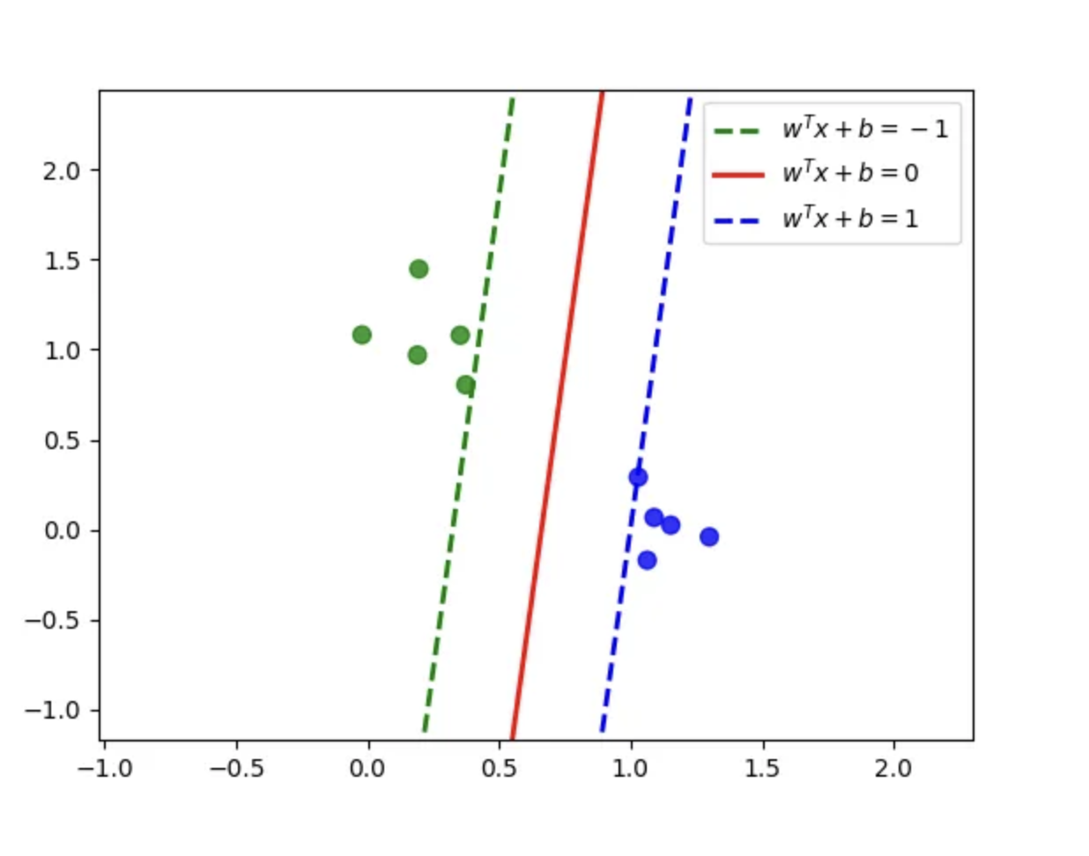
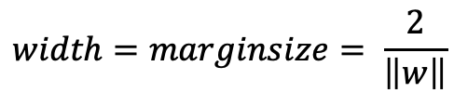


Mathematical Interpretation of Optimal Hyperplane
Classifying a point x (feature vector):
$$w^{T}∙x+b≥0⇒Blue$$
$$w^{T}∙x+b<0⇒Green$$
The width between the blue and green lines is defined as :
$$width=marginsize= \frac{2}{\left\|w\right\|}$$

Slide 5





Hard Margin Optimization Problem
Maximize the width of the margin to the constraint that points in the dataset should not be in the margin:
Constraints ($y_{i}$ = +1 or -1):
$$\max\left(\frac{2}{\left\|w\right\|}\right)=\min\left(\left\|w\right\|\right)or\min\left(0.5{\left\|w\right\|}^{2}\right)$$
$$s.t$$
$$y_{i}(w∙x_{i}+b)≥1$$
Or $min⁡(0.5{\left\|w\right\|}^{2})$ refers to suggestions that l2 regularization is more stable than l1
Data points should lie in a classifiable region.

Slide 6
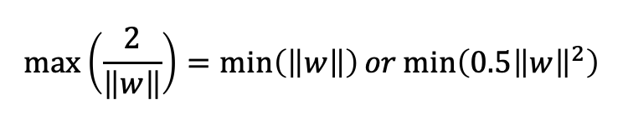
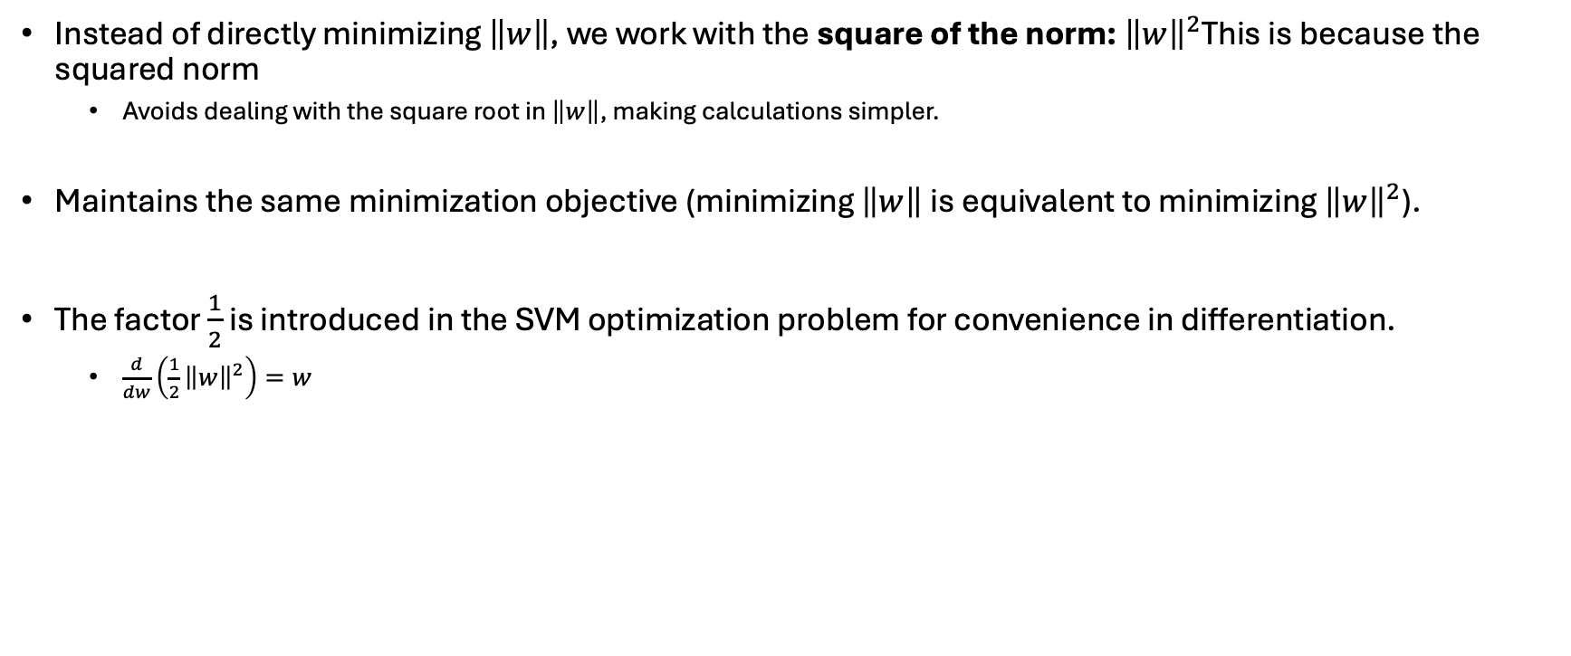

Why $\min\left(0.5{\left\|w\right\|}^{2}\right)$
Instead of directly minimizing $\left\|w\right\|$, we work with the square of the norm: ${\left\|w\right\|}^{2}$This is because the squared norm
Avoids dealing with the square root in $\left\|w\right\|$, making calculations simpler.
Maintains the same minimization objective (minimizing $\left\|w\right\|$is equivalent to minimizing ${\left\|w\right\|}^{2}$).
The factor $\frac{1}{2}$ is introduced in the SVM optimization problem for convenience in differentiation.
$\frac{d}{dw}\left(\frac{1}{2}{\left\|w\right\|}^{2}\right)=w$

Slide 7
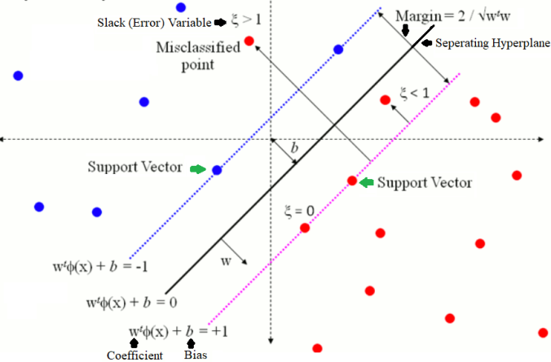
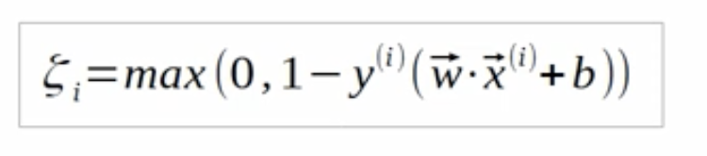

Linear Soft Margin – Slack Variable
If the classes +1 and -1 are mixed (as they usually are), which means they cannot be completely separated, they can be linearly separated by allowing for some error.
We assign a slack variable $ξ$ to each datapoint to allow misclassification.
Goal : find a decision boundary that minimizes total error $\sum{ξ}$ while maximizing the margin.

Slide 8
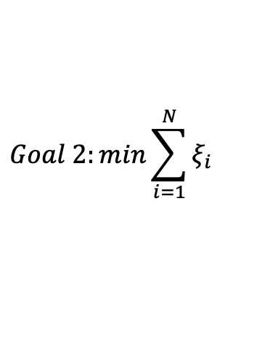
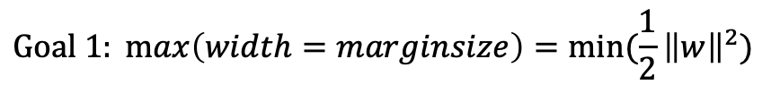

$$Goal 1: max\left(width=marginsize\right)=min⁡(\frac{1}{2}{\left\|w\right\|}^{2})$$
$$Goal 2:min\sum_{i=1}^{N}{ξ_{i}}$$
$$Combinded Obj fcn=min⁡[\frac{1}{2}{\left\|w\right\|}^{2}+C∗\sum_{i=1}^{N}{ξ_{i}}]$$

Slide 9
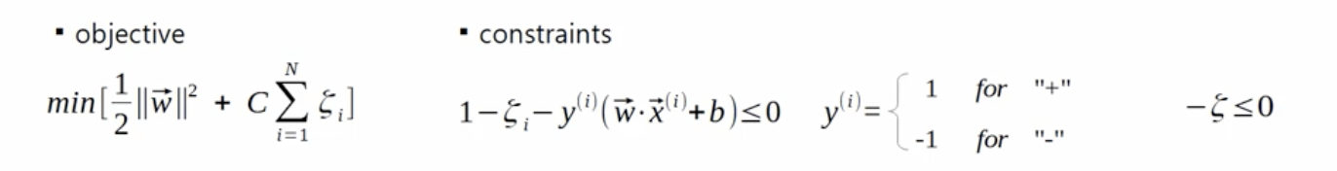
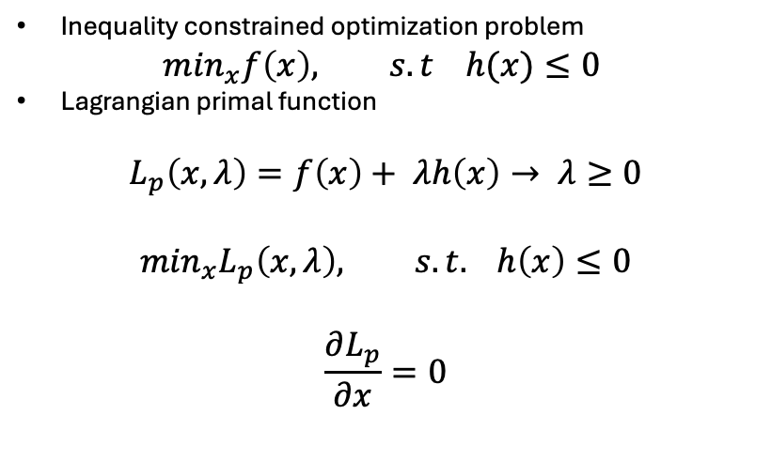
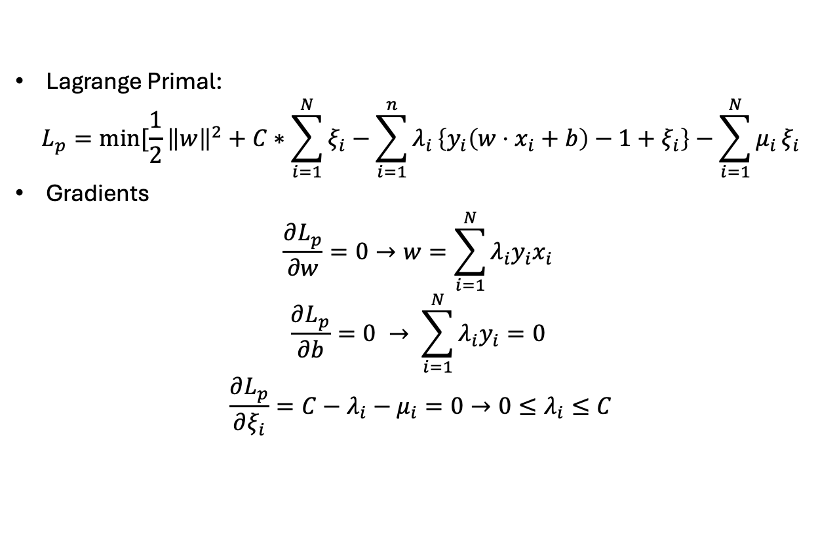
Lagrange primal
Lagrange Primal:
$$L_{p}=min⁡[\frac{1}{2}{\left\|w\right\|}^{2}+C∗\sum_{i=1}^{N}{ξ_{i}}−\sum_{i=1}^{n}{λ_{i}}\left\{y_{i}\left(w⋅x_{i}+b\right)−1+ξ_{i}\right\}−\sum_{i=1}^{N}{μ_{i}}ξ_{i}$$
Gradients
$$\frac{∂L_{p}}{∂w}=0→w=\sum_{i=1}^{N}{λ_{i}y_{i}x_{i}}$$
$$\frac{∂L_{p}}{∂b}=0 → \sum_{i=1}^{N}{λ_{i}y_{i}=0}$$
$$\frac{∂L_{p}}{∂ξ_{i}}=C−λ_{i}−μ_{i}=0→0≤λ_{i}≤C$$
Inequality constrained optimization problem
$$\min_{x}f\left(x\right), s.t h(x)≤0$$
Lagrangian primal function
$$L_{p}\left(x,λ\right)=f\left(x\right)+ λh\left(x\right)→ λ≥0$$
$$\min_{x}L_{p}\left(x,λ\right), s.t. h\left(x\right)≤0$$
$$\frac{∂L_{p}}{∂x}=0$$

Slide 10
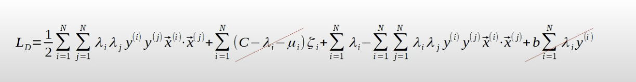
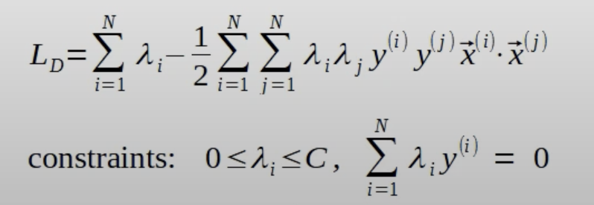
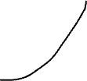
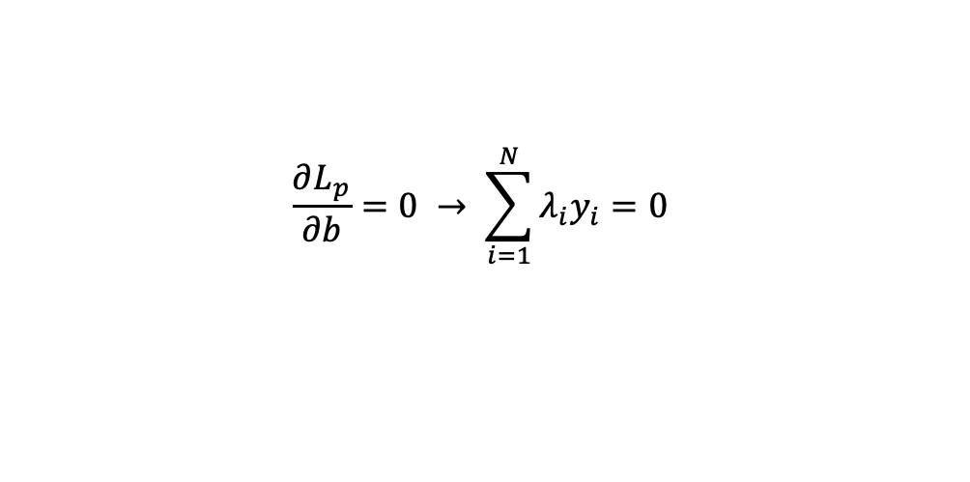




Lagrange Dual
$$\frac{∂L_{p}}{∂ξ_{i}}=C−λ_{i}−μ_{i}=0$$
$$\frac{∂L_{p}}{∂b}=0 → \sum_{i=1}^{N}{λ_{i}y_{i}=0}$$

Slide 11

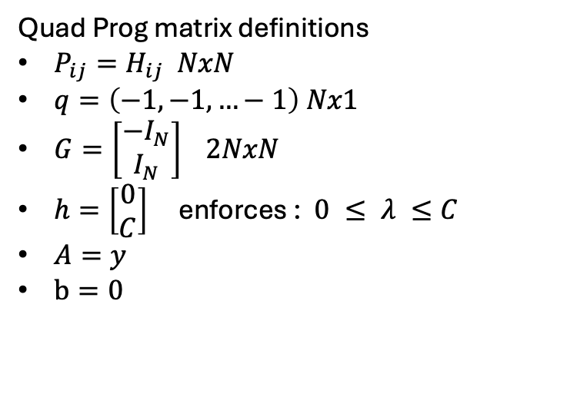

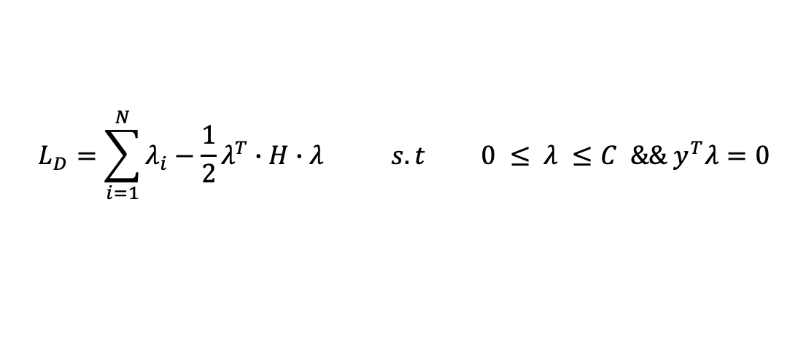

Solve with QP
Quad Prog matrix definitions
$P_{ij}=H_{ij} NxN$
$q=\left(−1,−1,…−1\right) Nx1$
$G=\left[\begin{matrix}{−I}_{N} \\ I_{N}\end{matrix}\right] 2NxN$
$h=\left[\begin{matrix}0 \\ C\end{matrix}\right]$ enforces :$0 ≤ λ ≤C$
$A=y$
$b=0$
$$L_{D}=\sum_{i=1}^{N}{λ_{i}}−\frac{1}{2}\sum_{i=1}^{N}{\sum_{i=1}^{N}{λ_{i}λ_{j}y_{i}y_{j}(x_{i}⋅x_{j})}}$$
$$H_{i,j}= y_{i}y_{j}(x_{i}⋅x_{j})$$
$$L_{D}=\sum_{i=1}^{N}{λ_{i}}−\frac{1}{2}λ^{T}∙H∙λ s.t 0 ≤ λ ≤C \&\& y^{T}λ=0$$
Solve using : cvxopt(Python) or quadprog(MatLab)

